Slide 1
PLAYER 1
HIGHSCORE 2500
PLAYER 2
GAMIFICATION
IN MOODLE
creating interactive content with moodle

Slide 2
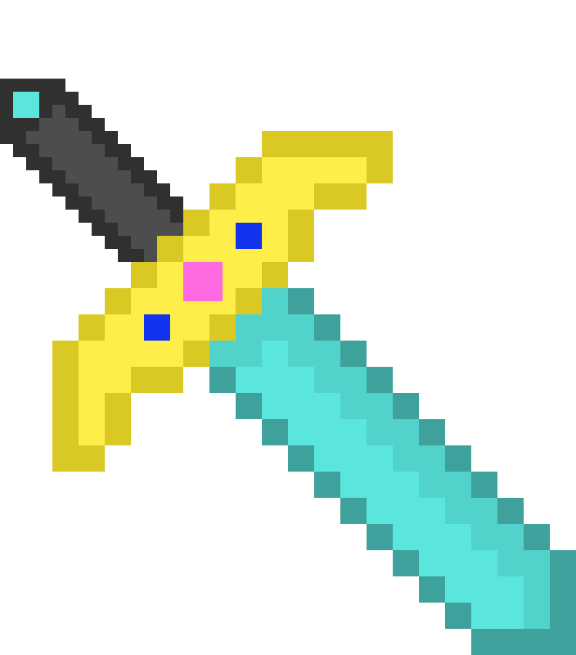
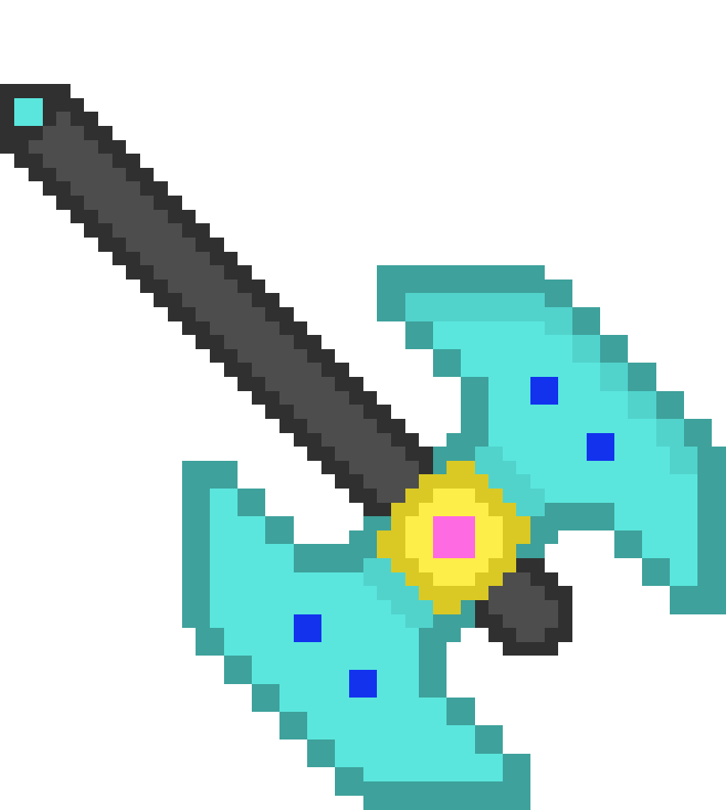
01
07
12
AGENDA
GAMIFICATION WITH MOODLE
didactic aspects
EXAMPLES
activities
lost in space

Slide 3
01
07
12
WHAT IS GAMIFICATION?
Use of Game Design Elements
in a Non-Game Context
people should feel part of
Something and be motivated
Promote Learning Through Playful
Means
Collecting Points, Badges,
Leaderboards, Level Systems, etc.

Slide 4
01
07
12
Achievable goals with entertaining
game experiences
ADVANTAGES OF GAMIFICATION
Students Feel More Engaged and
Responsible
Rewards Create a Record of Learning
Success

Slide 5
1) DEFINE LEARNING OBJECTIVES
2) SELECT GAMIFICATION ELEMENTS
3) STORYTELLING AND SCENARIOS
4. GAMIFIED ASSESSMENTS
STEP-BY-STEP GUIDE
5) TRACK PROGRESS
6) COLLABORATIVE CHALLENGES
7) BADGES OR CERTIFICATES
8) LEADERBOARDS
9) FEEDBACK
10) IMPROVEMENTS

Slide 6
HOW TO GAMIFICATION IN MOODLE

Slide 7
SPIELER 1
USING LEADERBOARDS
IN MOODLE
can promote healthy competition
showcase the top participants in Moodle
available to your students anonymously AS WELL
Some activities, such as the StudentQuiz,
already include a leaderboard feature

Slide 8
step 1:
consider a logical order in which activities or resources should be unlocked in Moodle.
Create all the necessary elements in your course.
USING COMPLETION
TRACKING IN MOODLE
step 2:
enable completion tracking under "Activity Completion."
Choose appropriate completion criteria for your elements based on the scenario.
STEP 3:
under "Restrictions," set the completion of previous activities as a prerequisite.
Now, the elements will be unlocked step by step as students sequentially work through them.

Slide 9
USING LEVEL SYSTEMS
IN MOODLE
topics become levels allowing participants
to track their progress through level
advancements
Terms like "review quizzes" transform into
"revival potions," and points become
ingredients
You can choose your own language to create a
unique world within your course

Slide 10
countdown
Missions
enhances engagement and focus by creating a sense of urgency and competition, motivating students to manage their time effectively
enhance engagement by providing goal-oriented tasks where each mission builds on the previous one, requiring students to complete and unlock each stage sequentially, fostering a sense of progression and accomplishment
MORE HELPFUL IDEAS
EASTER EGGS
add an element of surprise and fun, where hidden features or content are unlocked by completing specific tasks or missions, motivating students to explore and engage more deeply with the material
avatar/profiles
personalize the learning experience, allowing students to represent themselves and track progress
share your knowledge
H5p
storytelling
fosters a collaborative learning environment, where students contribute to discussions or help others, unlocking new insights and resources as they engage, thus building a sense of community and mutual growth
create interactive and fun activities using H5P such as quizzes, crosswords, flashcards, memory games etc.
enhances engagement, requiring students to unlock new parts of the story as they progress, fostering a deeper connection to the material and a sense of ongoing discovery

Slide 11
QUICK GUIDE
Consider the learning objectives that students should achieve by the end of
the course.
Which learning content can you enhance with playful elements?
Using a level design, students can gain or lose lives based on the number of
attempts in self-checks.
Display current progress.
Create a world around the entire course content.
introduce items like virtual coins that students can spend.
New content is unlocked per level as part of a story.
Engage students more deeply in the course through exciting discussions.

Slide 12
HELPFUL MOODLE ACTIVITIES
Choice
Group Assignments
Student
Quiz
H5P
Wiki
Workshop
Glossary
Checklist
Forum
E-Voting

